Slide 1
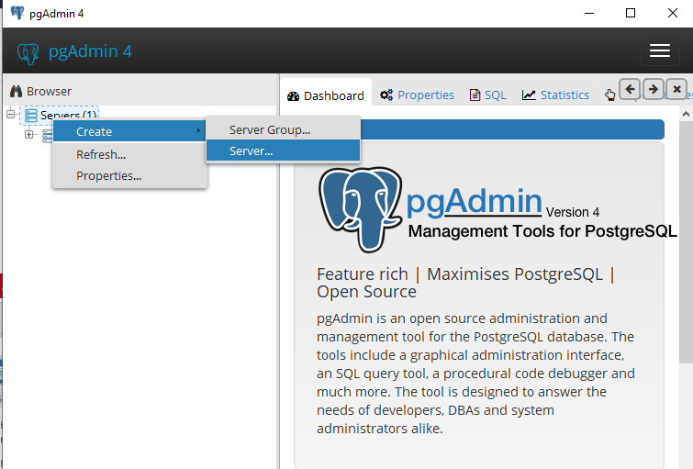
JDBC CONNECTION IN PG ADMIN
The main PGADMIN Page will be opened after that we need to connect to server.

Slide 2
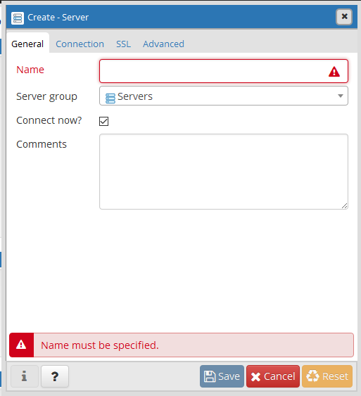
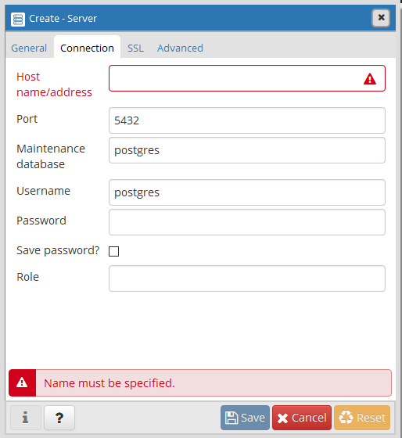
We create the server with a name and save it
Now add host address and add password to it which
is shared with you

Slide 3
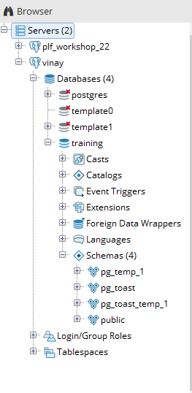
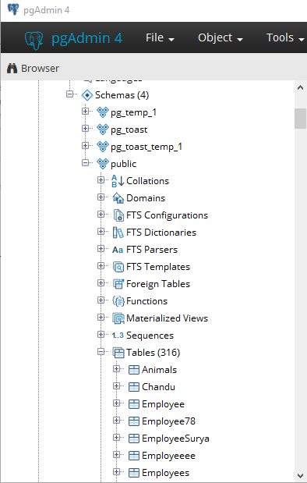
1
2
3
5
4
6
Follow these steps to create table

Slide 4
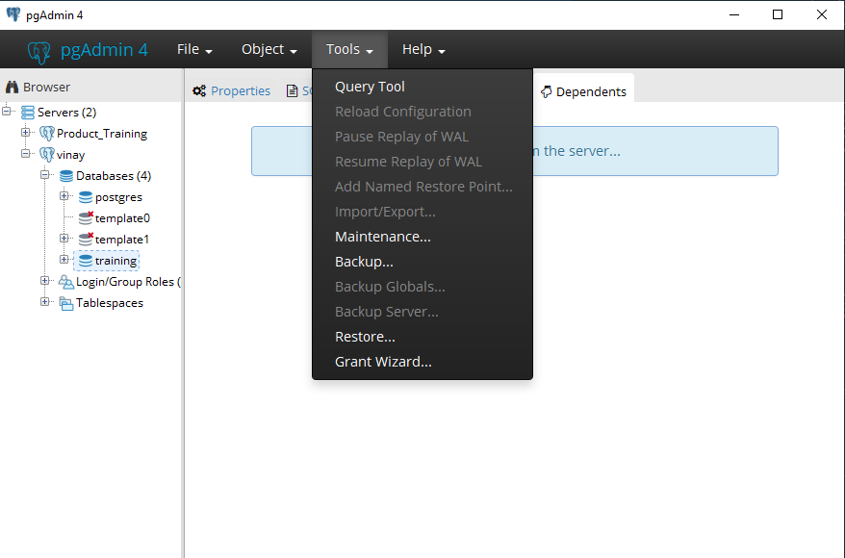
Click on Tools
and then
select Query tool
to write the queries

Slide 5
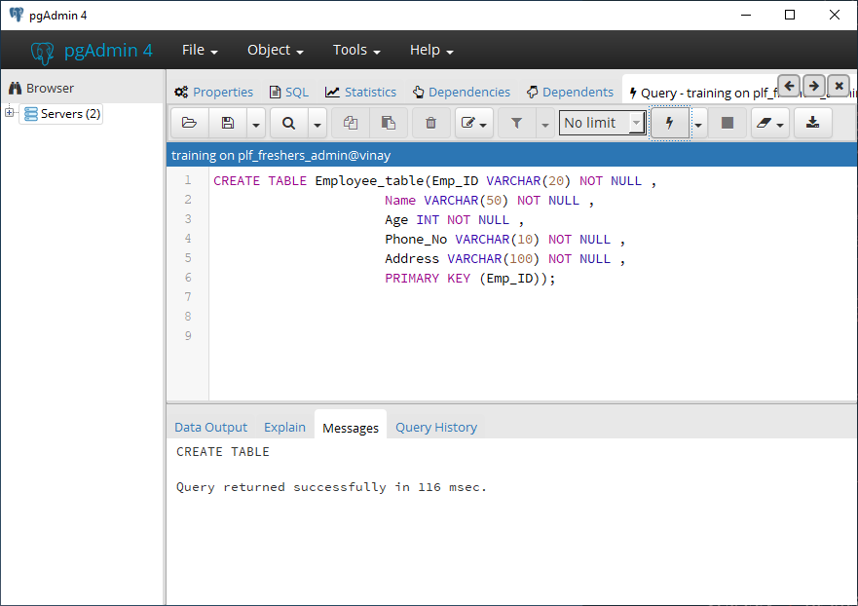
Now in Query tool
create table and write
the required fields of it
and then execute the
query
By selecting this we can
execute the written query

Slide 6
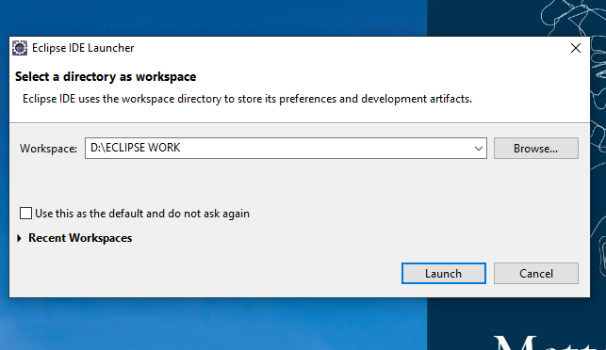
After opening the Eclipse we will get the workspace dialog box then we should create an empty directory in Local Disk(respective drive) then we should click on launch

Slide 7
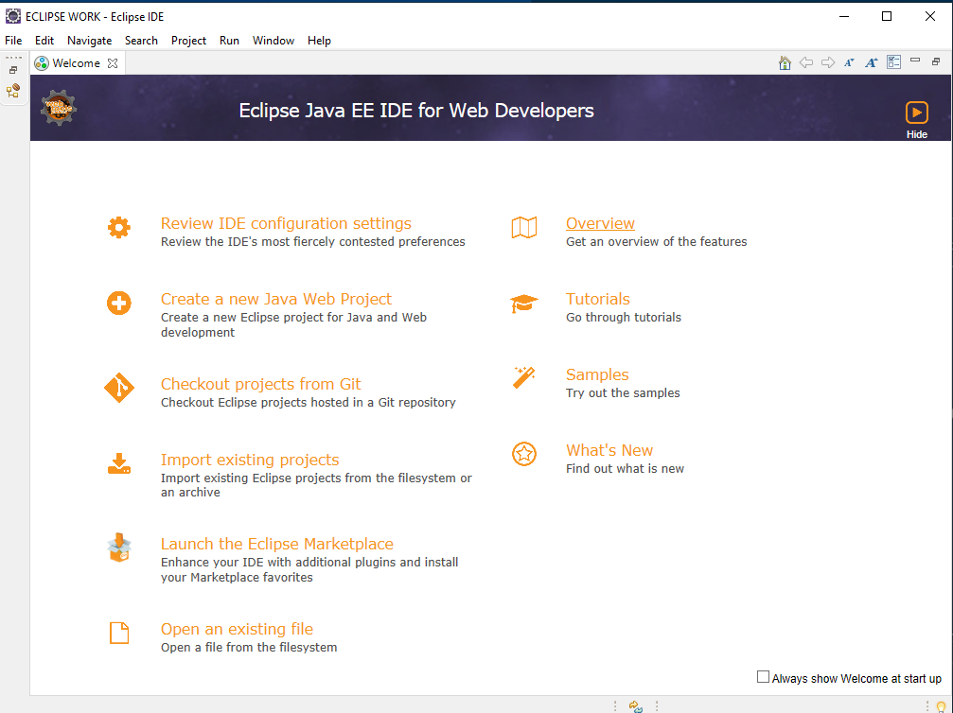
A welcome page will appears to create of our own projects based on our configuration

Slide 8
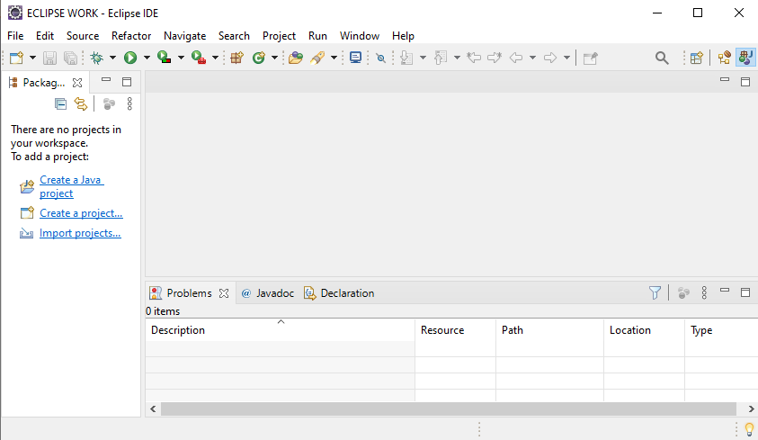
Click on the New we can create our own Java Project

Slide 9
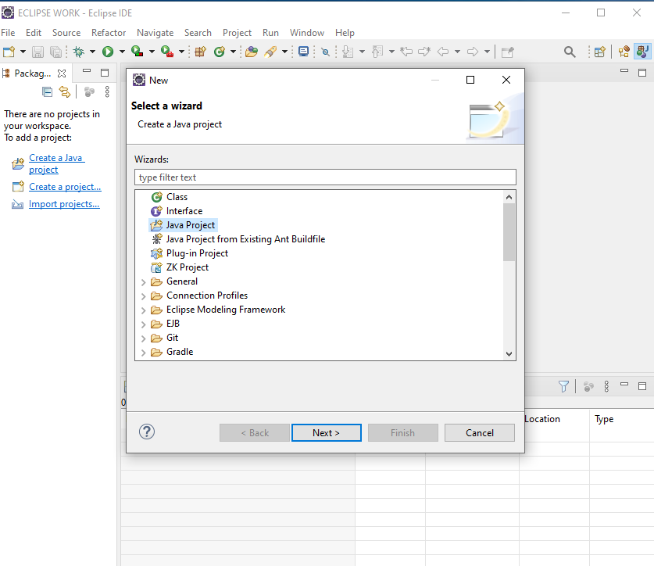
Choose the Java Project in the dialog box which will help to create a new Java Project

Slide 10
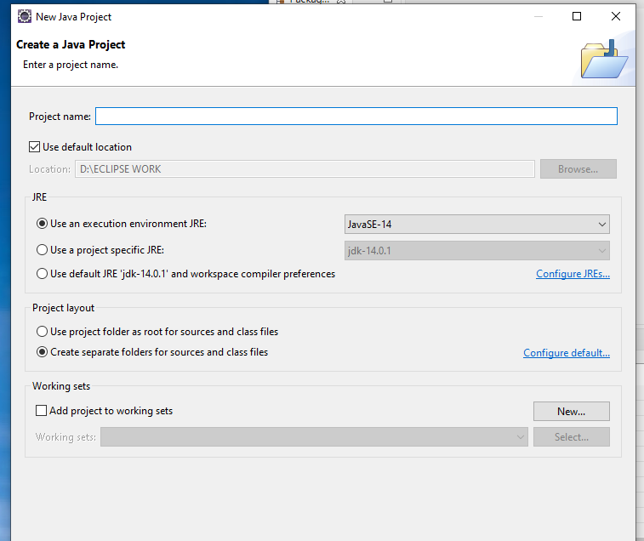
Here we have to write your own Project name and then click on finish

Slide 11
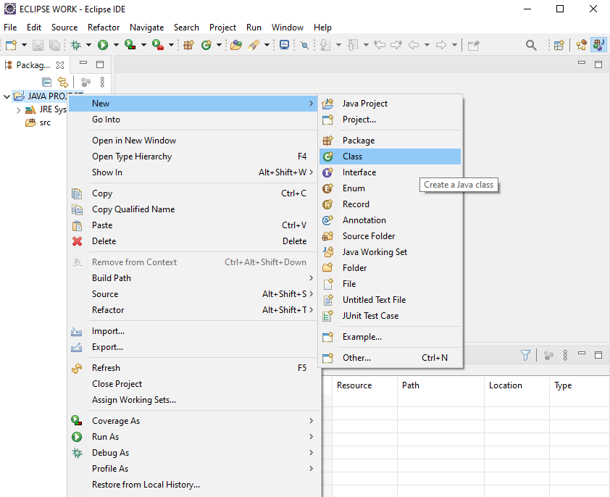
Now left-click on created project then choose new and then choose to create a class for your Java Program

Slide 12
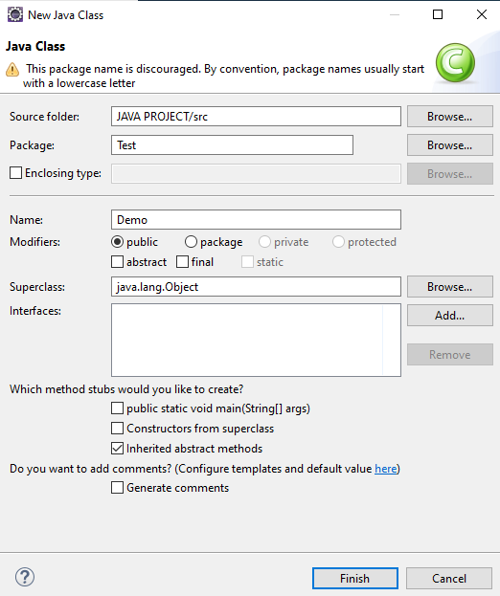
Here we give the Package and also Class Name of your own then we can create our own Java Project
Note:
Class name starting should always be capital.
It is always a best practice to give a Package name for the created class.

Slide 13
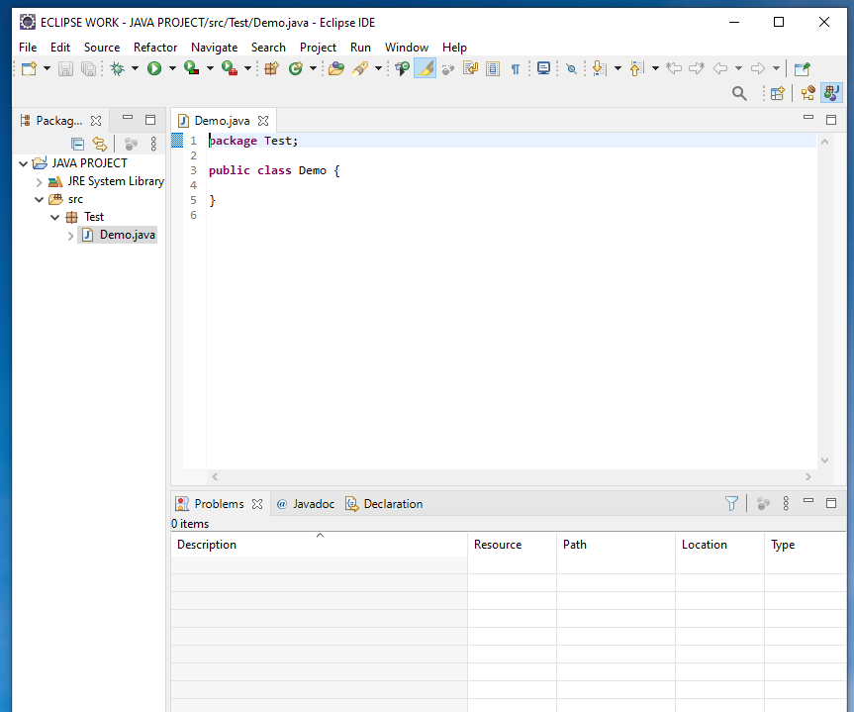
A Class has been created with class name and with a package of your own

Slide 14
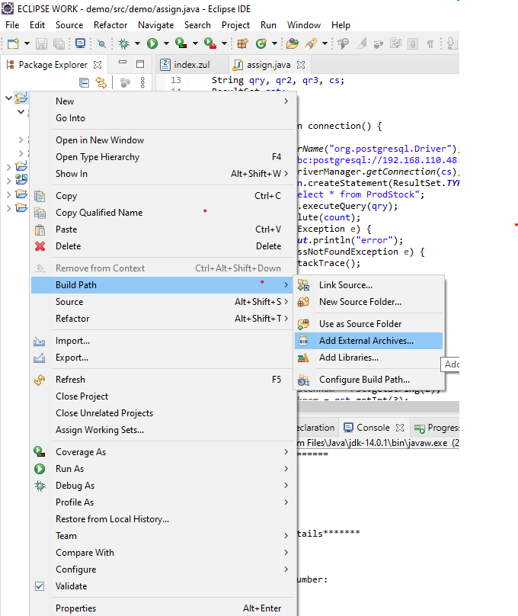
Now we need to add postgesql
in our running project .

Slide 15
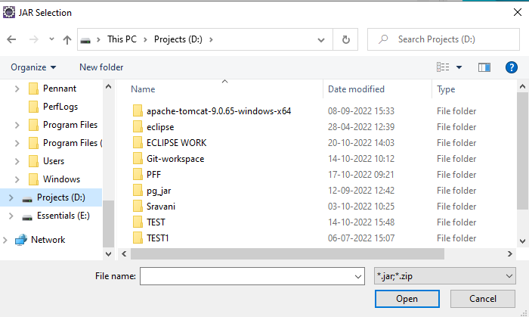
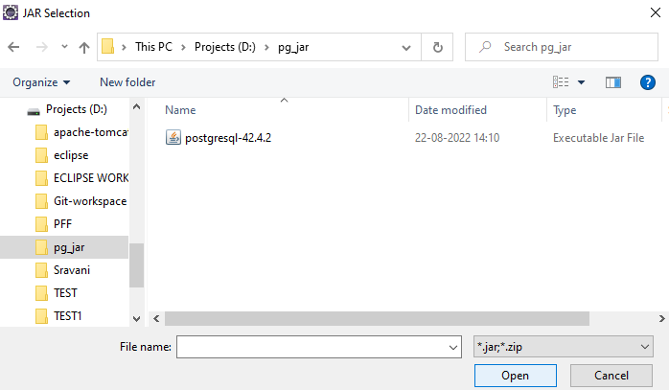
Now we need to choose the directory from the files and select pg_jar and choose postgesql from it

Slide 16
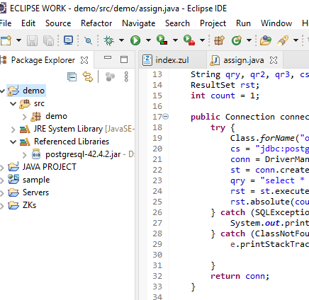
Now write the code and
run the program in eclipse

Slide 17
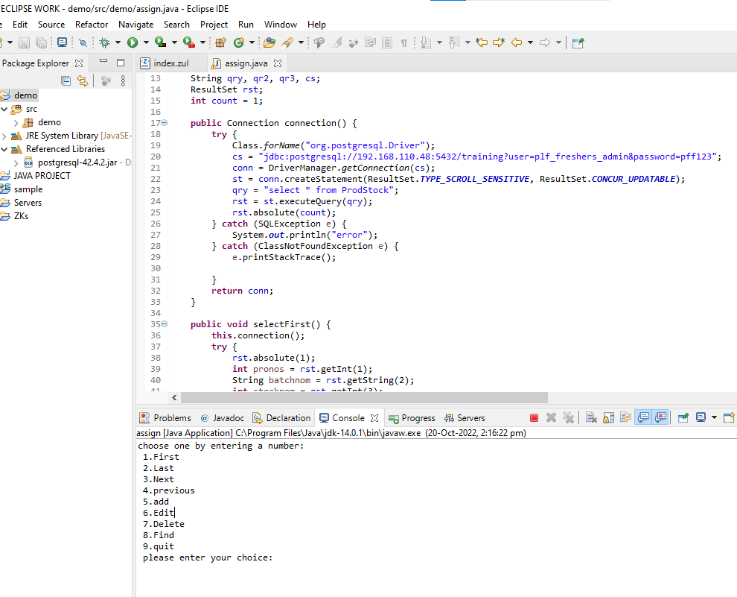
After clicking on run button we can see our Output in the Console Area

